Slide 1
Recommending the Best District in Houston for Opening a Restaurant
Nicholas Isakson

Slide 2
Restaurant favorability is useful for entrepreneurs
Restaurants exist on small profit margins with small advantages deciding who succeeds and who fails.
Being able to determine which districts are most favorable for new restaurants will provide this small advantage, allowing entrepreneurs to succeed.
A restaurant score can be determined to make this representation based on the success of similar competitors.

Slide 3
Data Acquisition
First, the names of each district in Houston was gathered from: https://en.wikipedia.org/wiki/List_of_Houston_neighborhoods
Once this was transformed into a dataframe, it could be analyzed with a geolocator to determine the latitude and longitude of each district.
A search could then be done of nearby venues using Foursquare API
Once the nearby venues were determined, they could be sorted based on popularity.

Slide 4
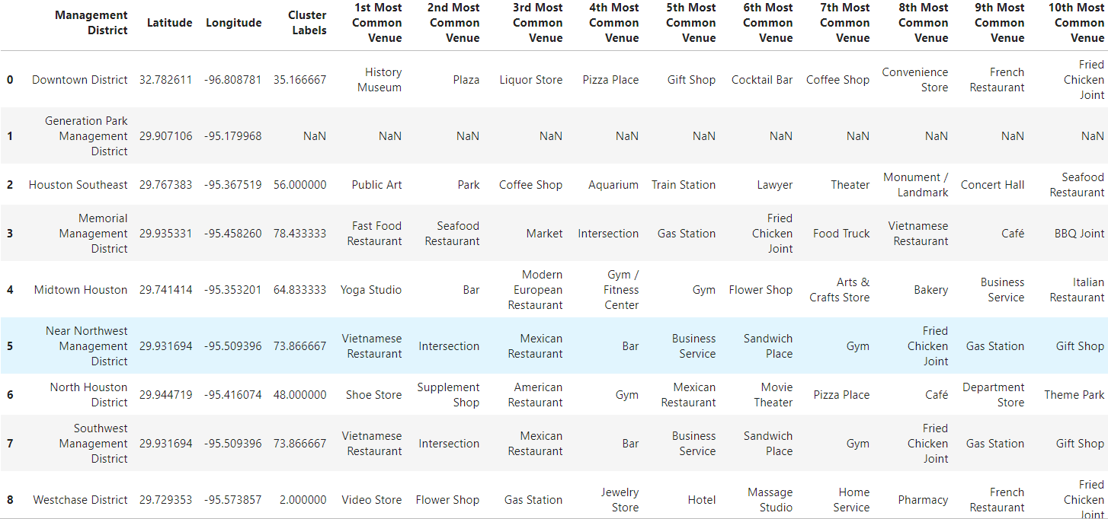
The result is this Table:

Slide 5
Determine a Restaurant Score
The restaurant score increases if restaurants in a particular district are higher on the most common venues list from before.
The restaurant score decreases the more restaurants in a particular district are in the top 10 most common venues because there are more competitors.
The result is the following equations:
District Restaurant Popularity=(11-Competitor Popularity Ranking)
Restaurant Score = District Restaurant Popularity / Number of Restaurants

Slide 6
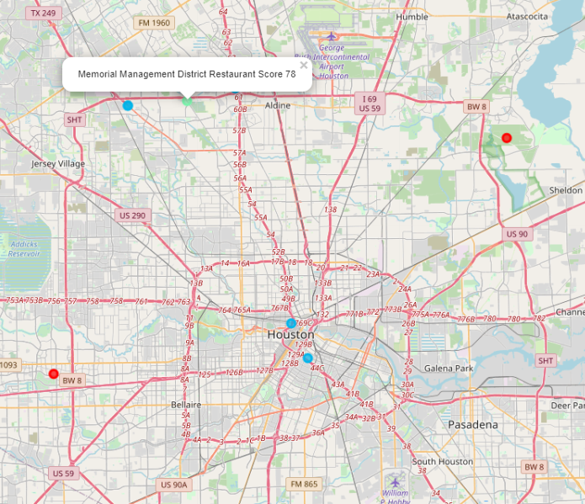
Generate a Map to Display Restaurant Scores
Brighter dots represent districts with greater restaurant scores.
Districts with greater restaurant scores are more favorable for opening a restaurant.
From the map, it is clear that Northwest Houston is the best area.

Slide 7
Conclusions
Memorial Management District is the best district to open a new restaurant in with a restaurant score of 78.
Northwest Houston is the most favorable region for new restaurants, having three districts with restaurant scores above 70.
Downtown Houston is the second best region, having multiple popular restaurants.

